Slide 1
Sora Analysis Project
By Damilola Ogunleke

Slide 2
Professional Background:
➢ 2012-2017: Bachelors Degree in Economics from University of Lagos, Nigeria.
➢ 2017-2019: Enterprise Risk Certified Professional (ERMCP)
➢ 2019-2022: Executive marketer and operations officer at Zenith bank Nigeria
➢ 2023- Present: Data Analyst Associate at Xtron, managing organization-wide data, business metrics, impact metrics, departmental KPIs and presenting reports to management for decision-making.
To excel in my varied background, I have developed and honed skills in MS Office & G-Suite especially MS Excel & Google Sheets for Data Analysis, Data visualization using Tableau and PowerBi, Data Query using tools like Bigquery, power bi and R studio.

Slide 3
Project Description:
To better understand the sales trend and revenue/ profit data of Soras various product categories and identifying patterns that would assist management in making smart, data-driven decisions
This will help us to:
Identify for which region more products should be channeled
Identify the most requested products and those that the prices can be increased for
What products marketing and advertising efforts should be tailored towards
Highlight products with low revenue return and should be reviewed
Create targeted strategies to increase the company's next quarterly revenue

Slide 4
DATA DESIGN METHODS
Data was acquired through a robust and error free manner and imported into excel
Data on product category sales and trends was cleaned using Microsoft excel ; missing values were handled, data was appropriately formatted, duplicates were removed , unwanted outliers were filtered and structural errors were fixed
Data manipulation techniques and statistical analysis like V-look up , Pivot tables were done using Microsoft Excel to understand patterns and elicit data for evidence-based decision making.
Data Visualization using Tableau and Microsoft Excel
This project focused on analyzing data on the following product categories: Furniture, Clothing, Electronics.

Slide 5
Findings & Insights

Slide 6
The total profit for each category
Category | Sum of Profit
Clothing | 11163
Electronics | 10494
Furniture | 2298
Grand Total | 23955
The total amount of profit in the categories analyzed during the course of this project is 23,955.
Of this number, majority of the profit (47%) was derived from the clothing category making this the most patronized category

Slide 7
2. Soras Sales trend 2015-2017
From the above pivot charts and sales data trend , Sora had her highest revenue generated from sales with a value of 32000 in march 2017 while her lowest revenue 9000, was generated through the months of April till December also in 2017
Highest average revenue was generated in 2016 at 13953.85

Slide 8
3. Most profitable sub-category
Of all sub-categories, Printers under the electronics category yields the highest profit of 5964
Tables is the least profitable sub-category at a loss of 4011.

Slide 9
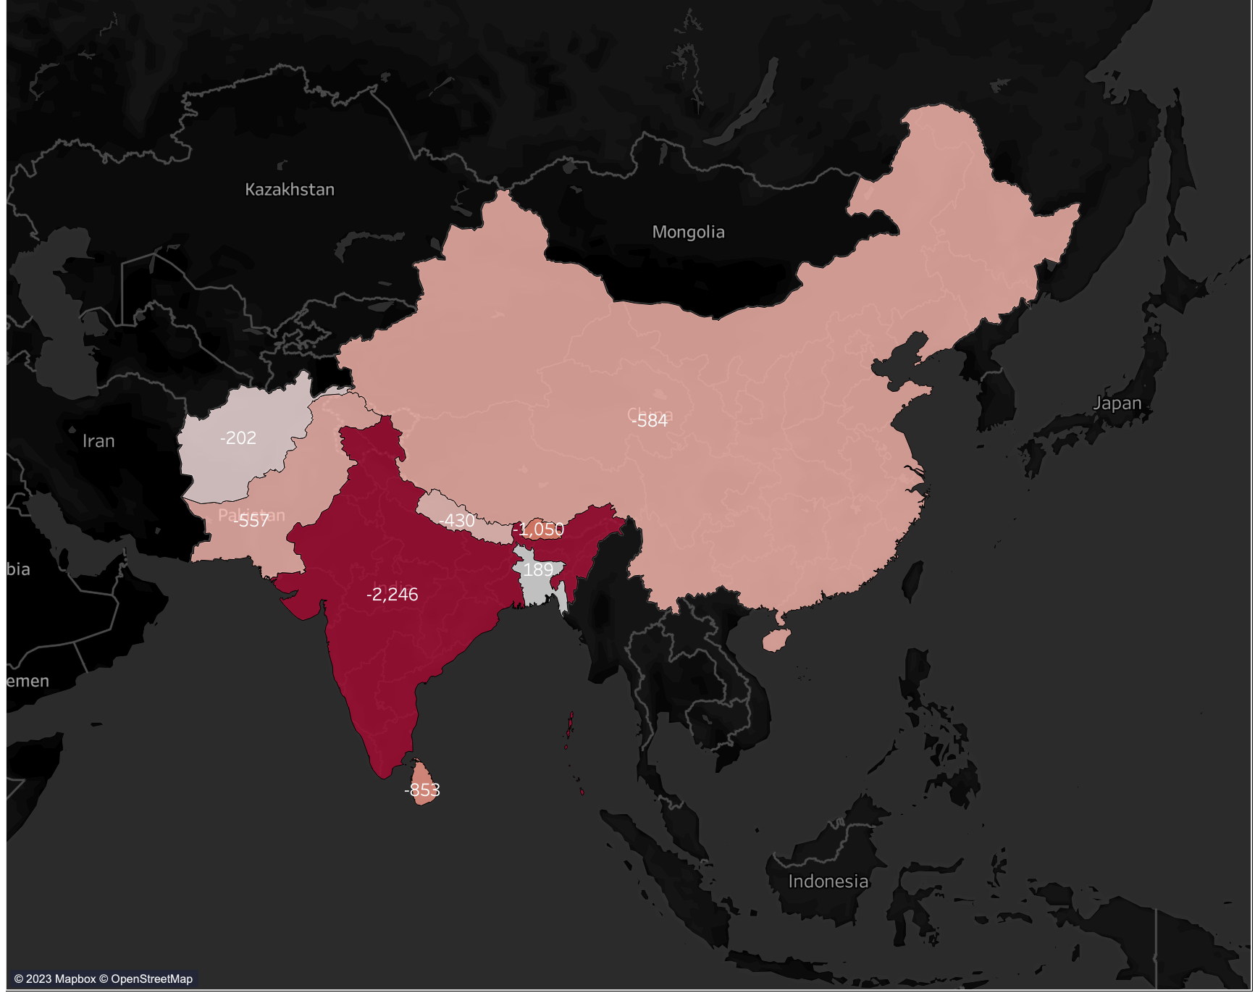
4. Most profitable country?
Map Visualization from Tableau shows that Sora generates its highest profit from Bangladesh.

Slide 10
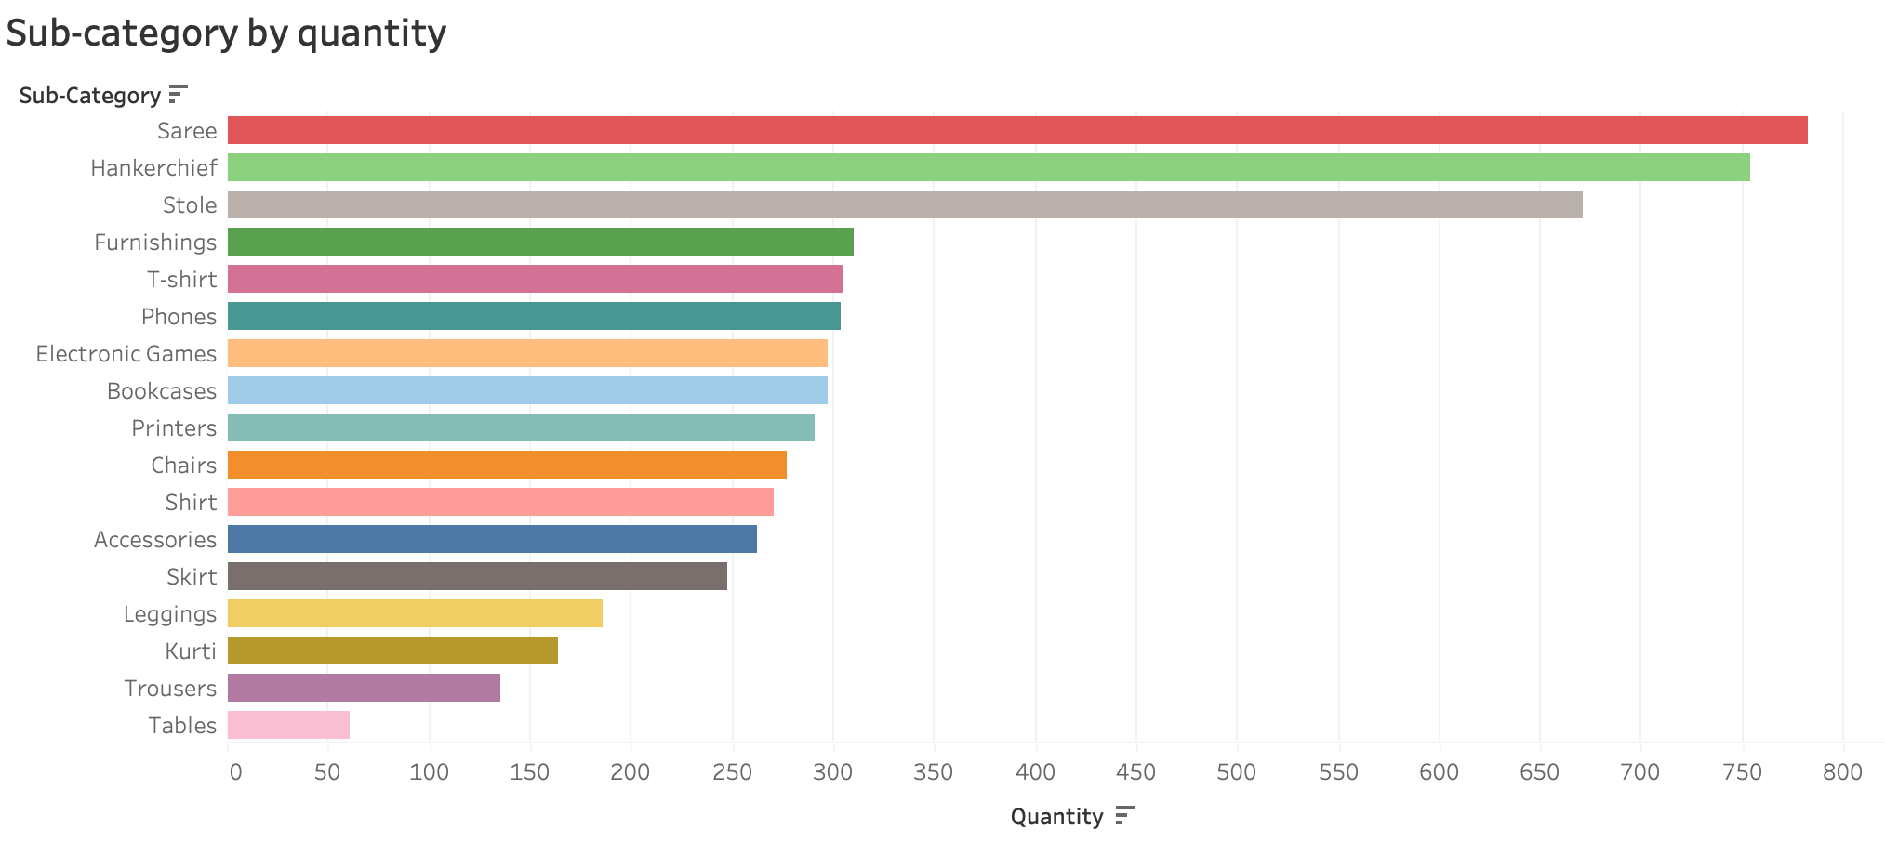
5. Most purchased sub-category
Amongst all sub-categories, saree is the sub-category with the highest sales followed accordingly by handkerchief and stole. Due to the high demand of purchase request for these 3 sub-categories, it would be advised that their price should be increased in order to maximize Soras profit and revenue.

Slide 11
6. Correlation between profit and quantity
There is no correlation between Profit and Quantity sold when considering all purchase categories together as most quantity sold is under 20 hours but the profit are almost evenly spread out. Also, taking a look at the data points in white, they exist within the same quantities but are on opposite ends of the profit spectrum with other similar data points scattered in between.

Slide 12
Executive Summary:
Almost 50% of the total customers come from the clothing product category
Saree is the most purchased sub-category despite tables having the highest average price
This means that beyond quantity produced and price, there are other factors that are responsible for the high purchase of Sarees.
To increase revenue, prices of Sarees and handkerchiefs can be increased since the interest is there. Marketing and advertising efforts should also be channeled towards promoting these product sub-categories
Average sales in 2017 performed poorly when compared to the revenue inflow derived in 2015. Marketing techniques used in 2015 should be investigated and deployed in order to achieve high sales again.
Bangladesh has the best sales performance amongst all countries more attention from the marketing team should be focused here

Slide 13
Recommended actions:
Our data tells us that Sarees are most purchased and people are willing to pay for it while Bangladesh is the most profitable country with the highest sales. Marketing and advertising campaigns should therefore be channeled more towards the product and country respectively.
Per unit price of Saree and handkerchief can be slightly increased to boost revenue inflow. Prices of poor performing products like Tables can be reduced, discounts offered and incentives like (referral discounts, buy one get one free) offered in order to boost its sales.
Quantity of poor performing products should be reduced to reduce production cost. Increase quantity of popular courses that people are more willing to pay for.

Slide 14
Thank you!

